Slide 1
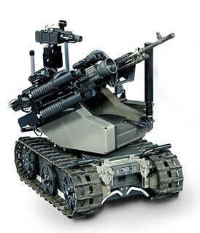
ROBOTICS IN WARFARE Transforming Modern Combat
This Photo by Unknown Author is licensed under CC BY-SA-NC

Slide 2
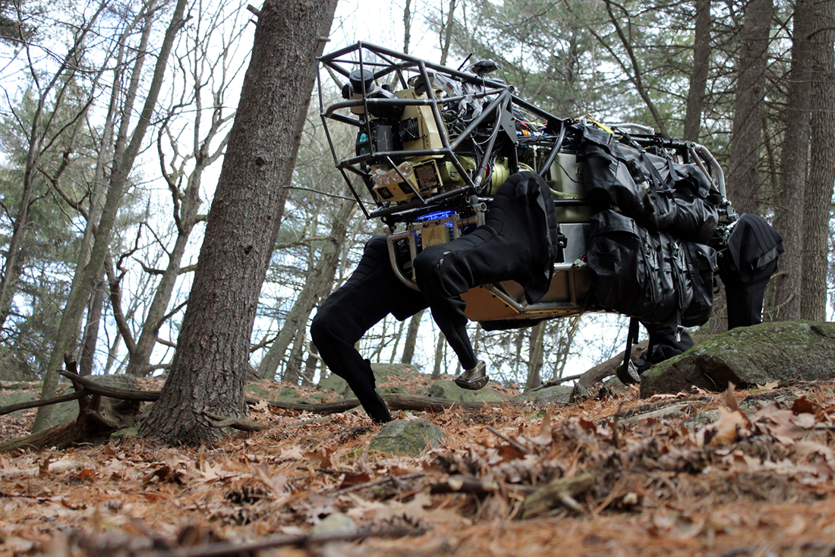
INTRODUCTION Robotics is revolutionizing warfare with increased autonomy , precision, and reduced risk to human life.
This Photo by Unknown Author is licensed under CC BY-NC-ND

Slide 3
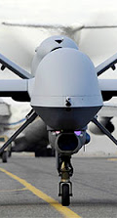
SURVEILLANCE & RECONNAISSANCE Drones (e.g.,MQ-9 Reaper) Ground robot (e.g., PackBot) Underwater vehicles( e.g., Drive-LD)
This Photo by Unknown Author is licensed under CC BY-NC

Slide 4
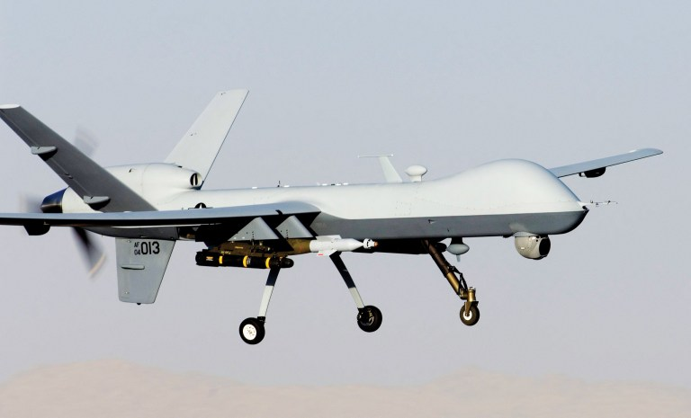
COMBAT & ATTACK
Drones (e.g., Altius, Valkyrie, Switchblade)
,Ground robots (e.g., ULTRA, MAARS)
,Counter-drone systems (e.g., Anvil, DroneGun)
This Photo by Unknown Author is licensed under CC BY-SA

Slide 5
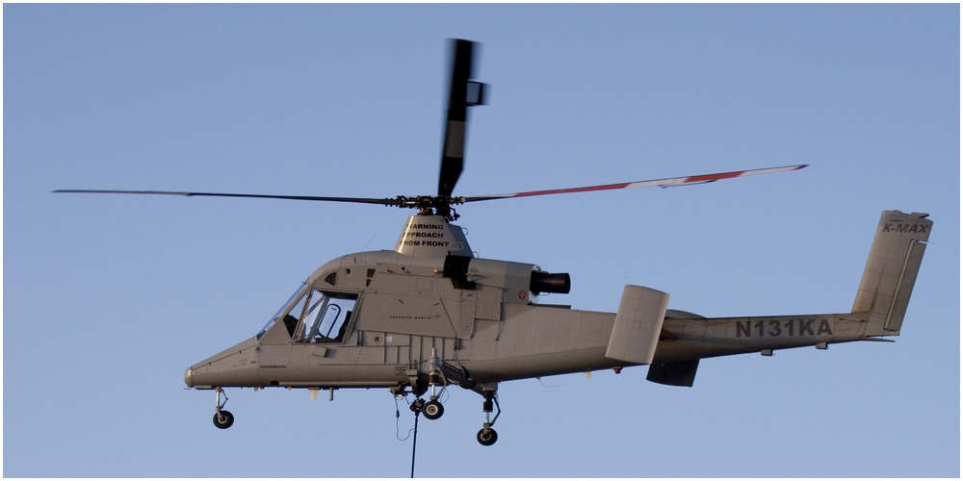
LOGIATICS & SUPPLY
Autonomous vehicles for supply transport (e.g., K-MAX, SMSS)
Drones for medical delivery (e.g., Zipline, Matternet),
This Photo by Unknown Author is licensed under CC BY-SA-NC

Slide 6
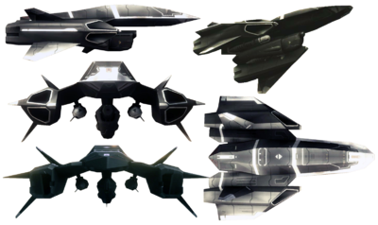
SPACE WARFARE
Satellites for space domain awareness(e.g.,GPS)
Autonomous space systems(e.g.,X-37B)
This Photo by Unknown Author is licensed under CC BY-SA

Slide 7
BENEFITS
Increased; safety
efficiency
accuracy
Reduced casualties

Slide 8
CHALLENGES
Ethical concerns
Cybersecurity risks
Dependency on tech

Slide 9
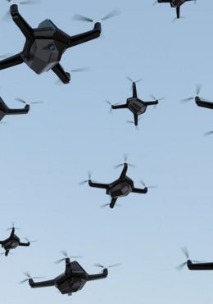
FUTURE OF ROBOTICS IN WARFARE
Expect more autonomy , AI-powered tech and swarming drones.
This will be more intense.
This Photo by Unknown Author is licensed under CC BY-NC

Slide 10
COMPANIES IN DEFENSE TECH
General Atomics(MQ-9 Reaper)
Kratos Defense(Valkyrie drone)
Palantir(AI-powered data analytics)
Edge Group(partnering with Anduril)
Anduril(Altius)

Slide 11
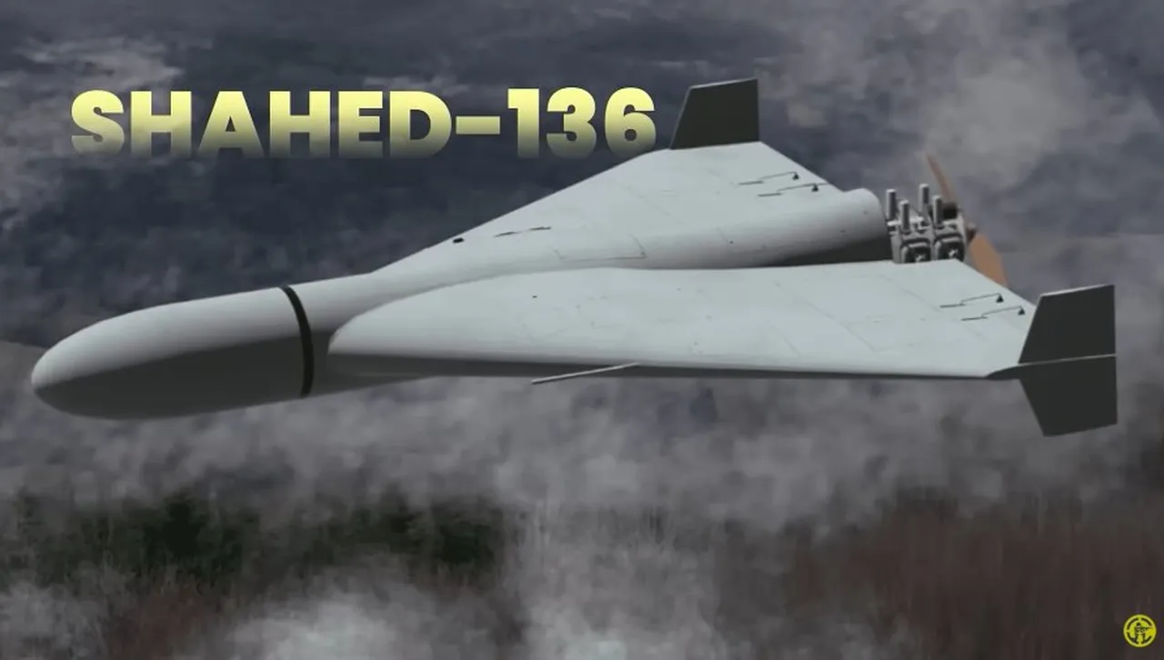
COUNTRIES THAT ARE USING ROBOTS IN WARFARE
Ukraine
Israel
China
United States
The SHAHED-136 used by Ukraine in war
This Photo by Unknown Author is licensed under CC BY-SA-NC

Slide 12

CONCLUSION
Robotics is transforming warfare , offering new capabilities and challenges
This Photo by Unknown Author is licensed under CC BY-SA

Slide 13
thank you
by : team phinix

